Slide 1


Telecom Churn Prediction
Prepared by: Darsh Patel
Vinay Bali
Dev Thakkar
Abhishek Panchal

Slide 2
TODAY’S AGENDA
01
Introduction
Problem Statement
02
Exploratory Data Analysis
03
Classification Algorithms
04
Model Conclusion
04
05

Slide 3
INTRODUCTION
Customer churn is a serious threat to profitability in the telecom sector. Accuracy in traditional churn prediction methods is frequently lacking. Our project's goal is to create a predictive model that can recognize clients who are likely to leave based on their usage habits, demographics, and service-related information by utilizing machine learning algorithms. This will make it possible for telecom firms to put targeted retention strategies into place, which will ultimately lower churn rates and boost overall company performance.

Slide 4
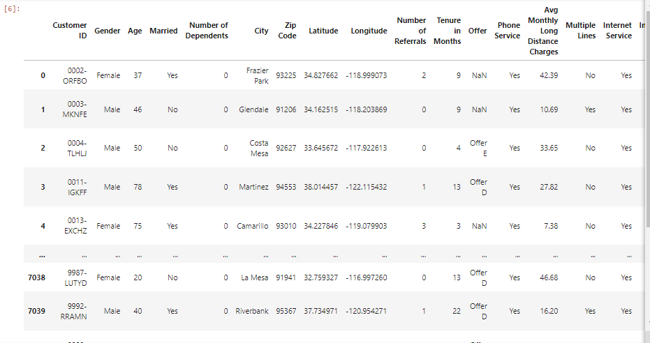
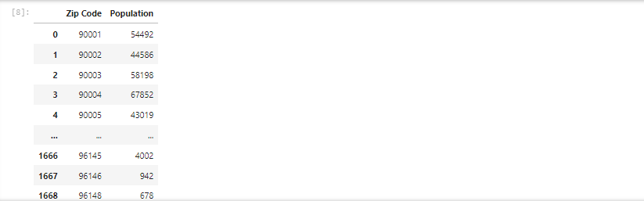
Description of Dataset

Slide 5
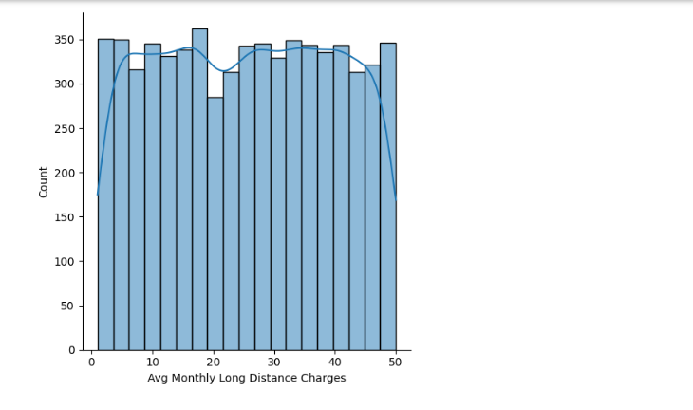
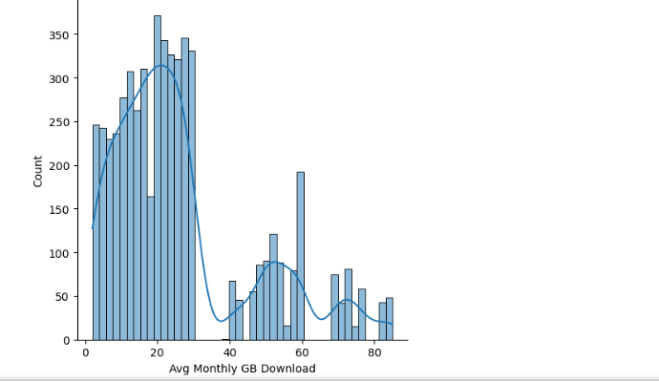
Exploratory Data Analysis

Slide 6
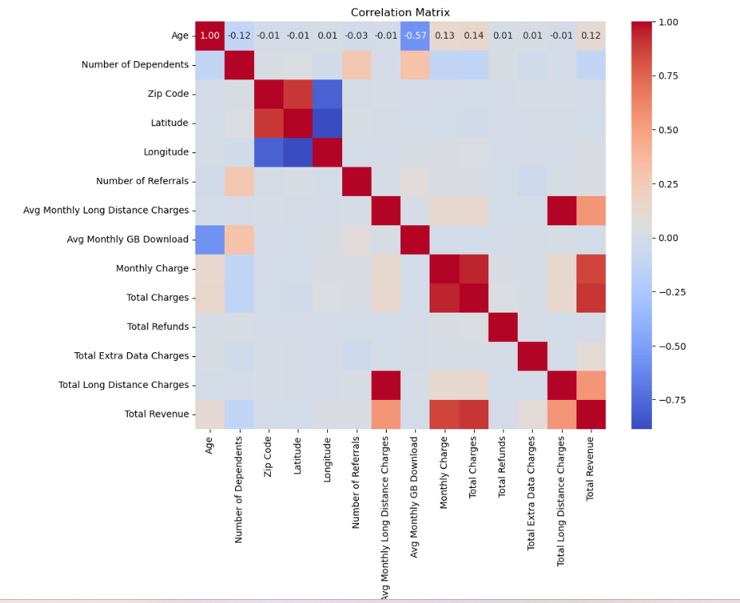

Slide 7
Data Preprocessing Techniques
After understanding our dataset through EDA visualization we applied, the following data preprocessing techniques:
Handling Missing Values:
Filled missing values in 'Avg Monthly GB Download' with 0.
Checked for remaining missing values using isna().sum().
Handling Categorical Variables:
Examined value counts of internet-related object columns to understand the data.
Filled missing values in internet-related object columns with 'Not Applicable'.
Applied one-hot encoding to columns 'Offer', 'Multiple Lines', 'Payment Method', and internet-related object columns.

Slide 8
Data Preprocessing Techniques
Binary Encoding:
Converted binary categorical variables like 'Gender', 'Married', 'Phone Service', 'Internet Service', and 'Paperless Billing' to numerical format (0 or 1) using numpy's where function.
Ordinal Encoding:
Converted 'Internet Type' and 'Contract' columns to numerical format based on a predefined order.
Geographical Information:
Merged dataset with population data based on zip codes for additional information.
Created binary columns for the most populated cities and dropped the 'City' column.
Data Separation:
Separated the dataset into two parts: customers who have joined and customers who have churned or stayed.

Slide 9
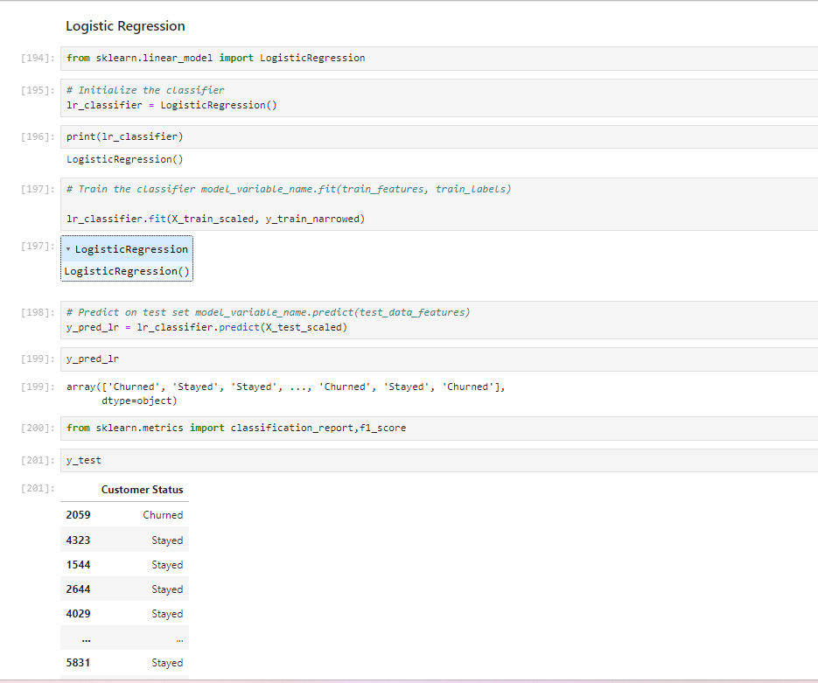
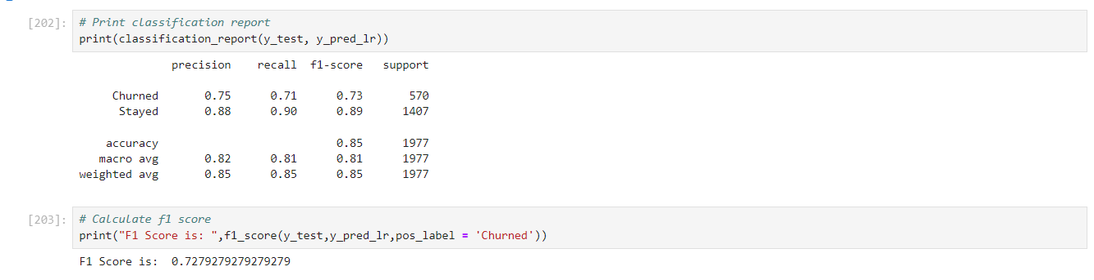
Logistic Regression Classifier

Slide 10
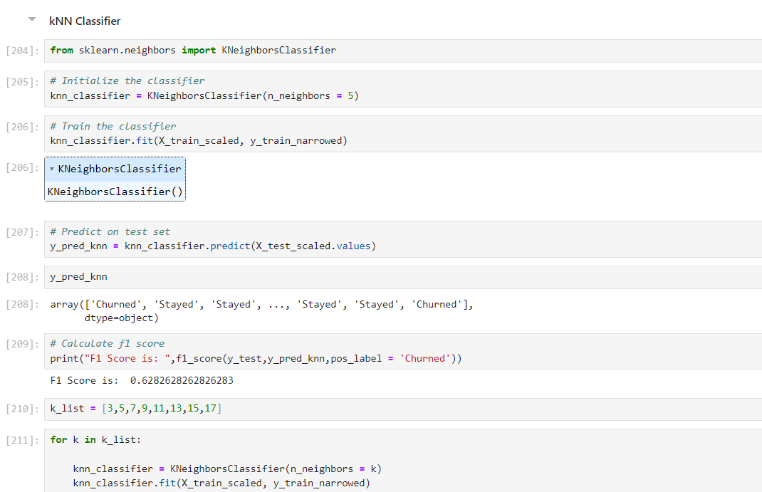
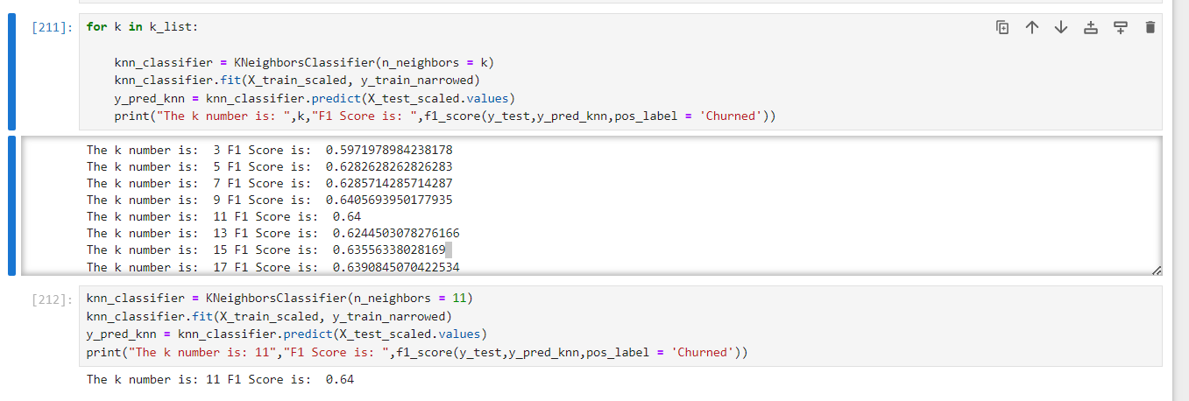
K-Nearest Neighbors Classifier

Slide 11
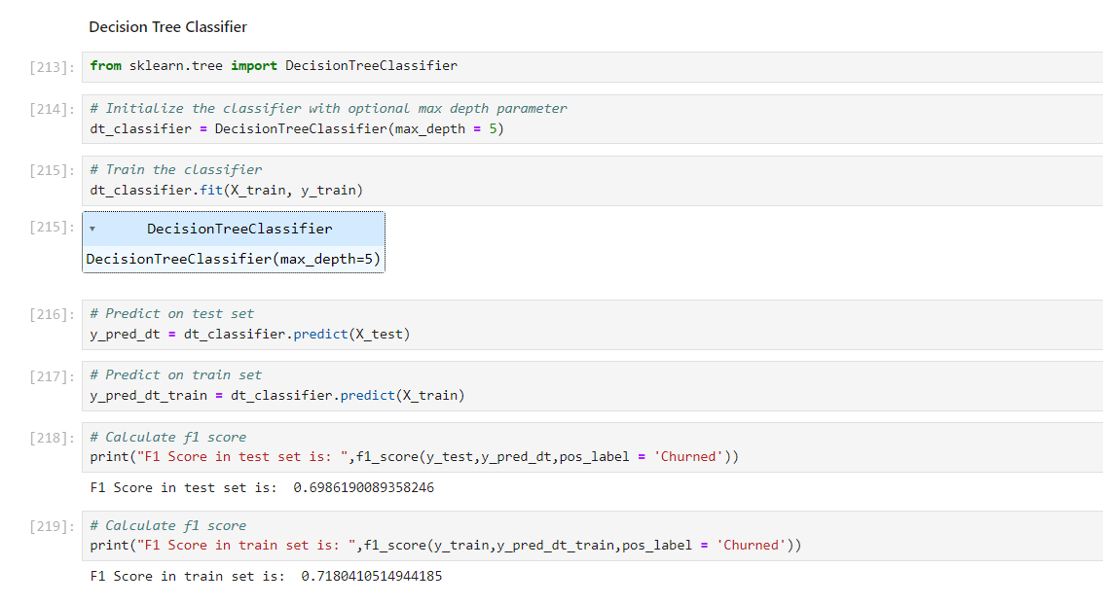
Decision Tree Classifier

Slide 12
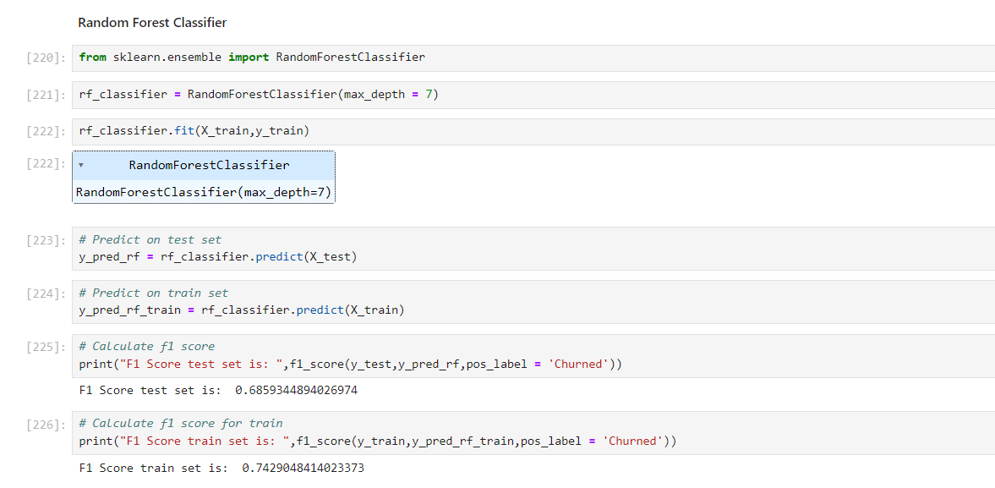
Random Forest Classifier

Slide 13
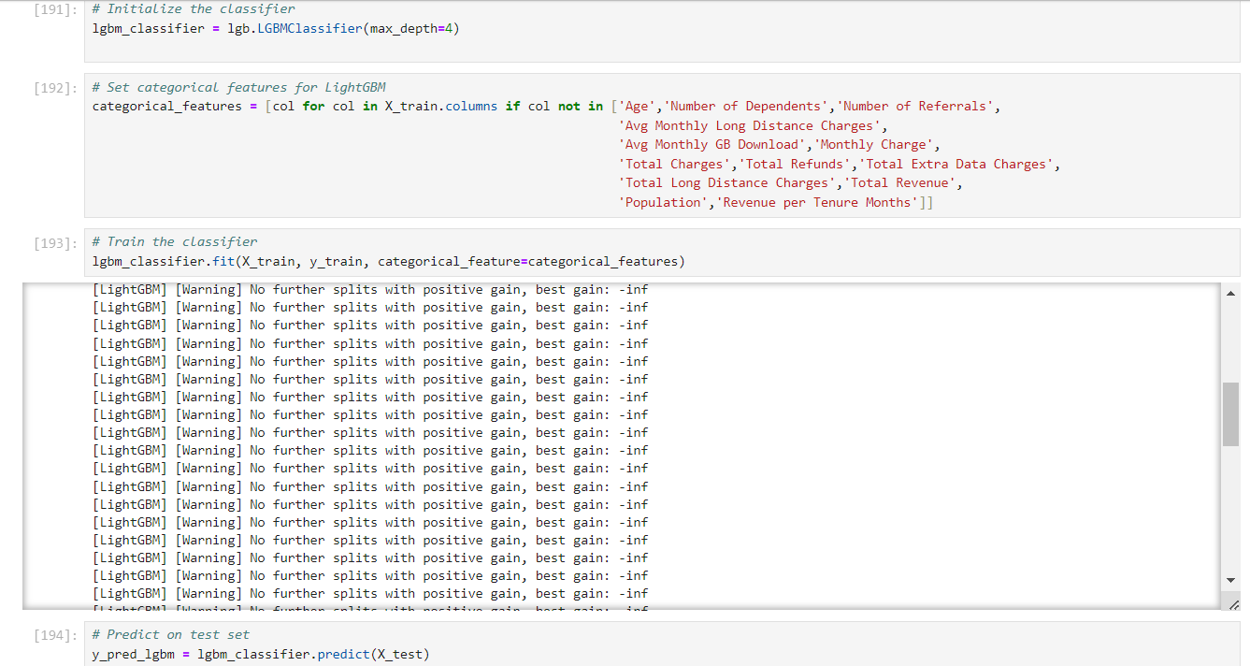
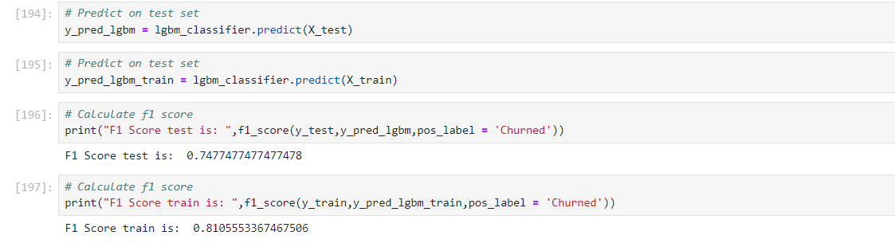
LightGBM Classifier

Slide 14
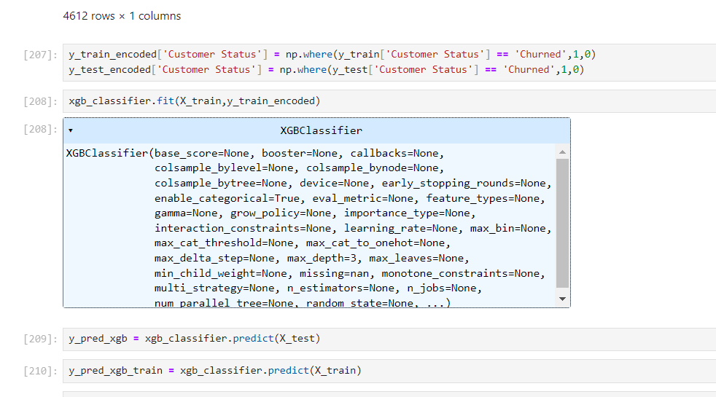
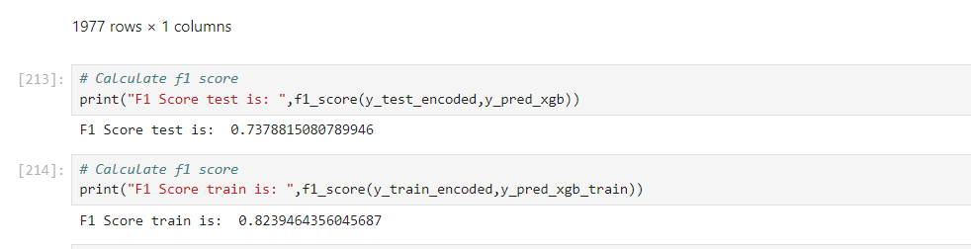
XgBoost Classifier

Slide 15
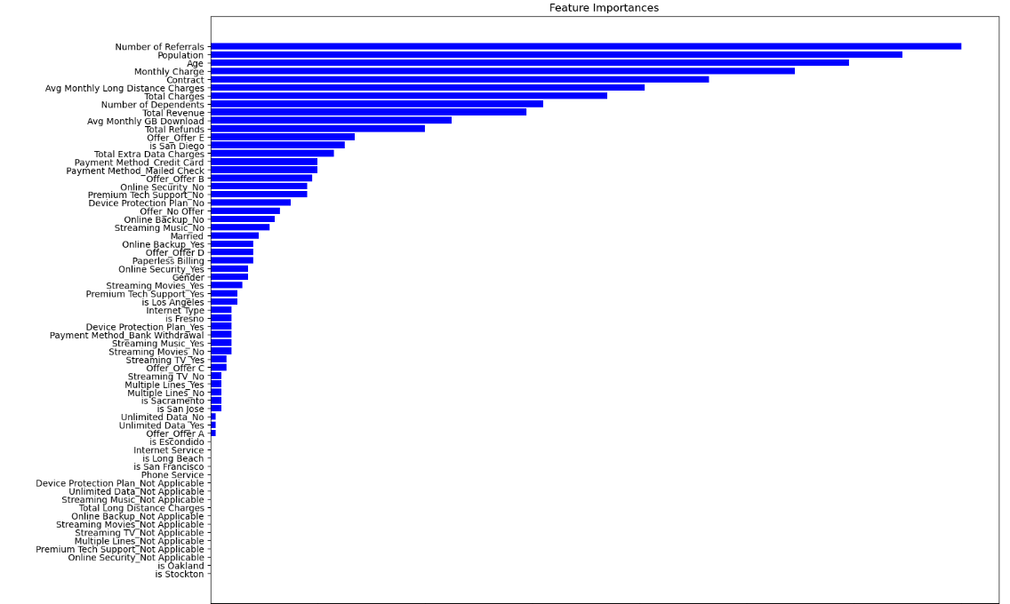

Slide 16
Model Conclusion
Model Accuracy: The XGBoost model achieved 82% accuracy, demonstrating its efficacy in forecasting customer attrition in the telecom sector.
Practical Implications: By proactively identifying at-risk customers and implementing focused retention strategies, telecom companies can lower attrition rates and increase customer satisfaction.

Slide 17
Thank You!

